Slide 1
Word2Vec, Doc2Vec
2021.05.06
KAIST 지식서비스공학 대학원
Cheonsol Lee

Slide 2
1
Embedding
2
Word2Vec
INDEX
3
Doc2Vec
4
Practice
5
Conclusion
6
Document Embedding

Slide 3
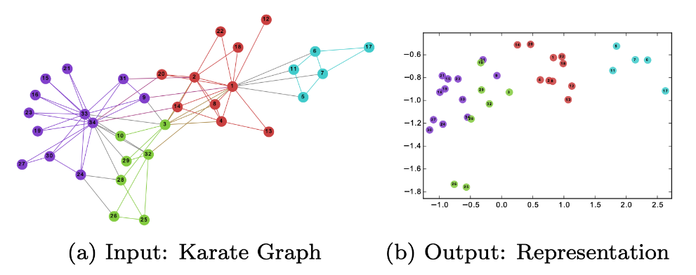
1. Embedding
Why do we convert text/documents into embedded space?
Difficulty of using ML/DL
Space efficiency due to compressed representation
Calculate similarity between vector spaces
Research papers
(Word2Vec) Efficient Estimation of Word Representations in Vector Space
(Doc2Vec) Distributed Representations of Sentences and Documents

Slide 4
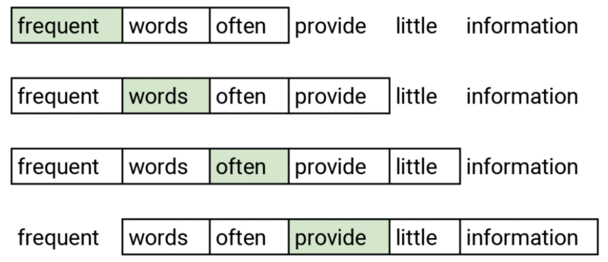
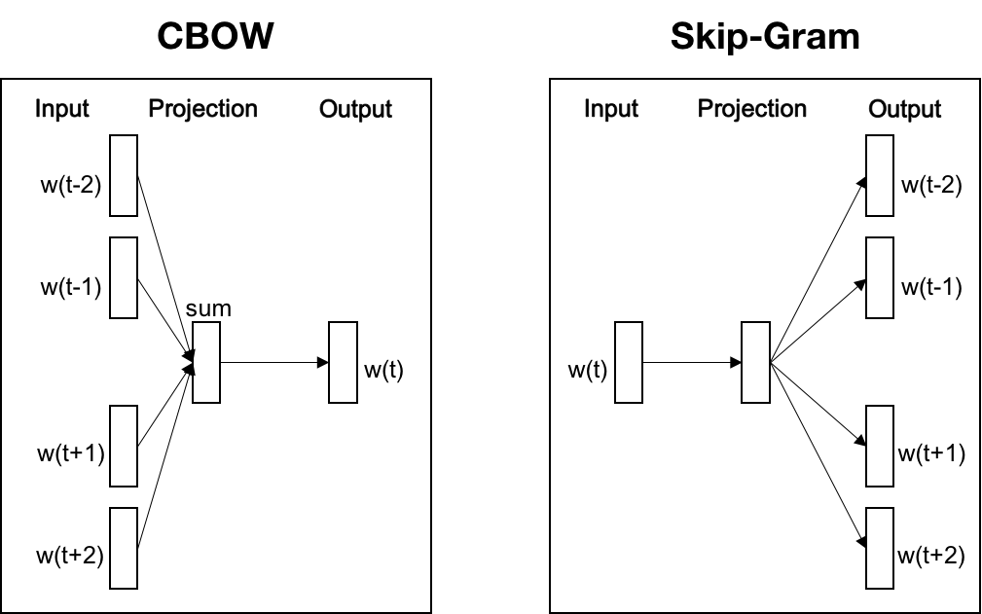
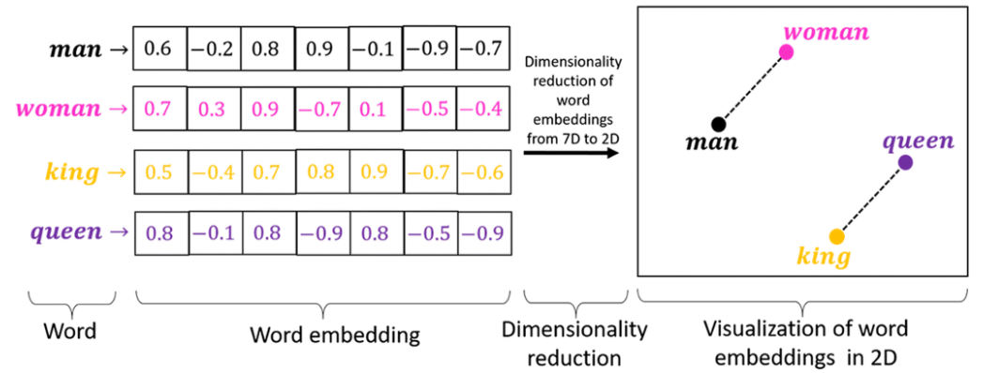
2. Word2Vec
Type
CBOW(Continuous Bag-of-Words)
Skip-gram
<Sliding Window>
<Model>
<Example>

Slide 5
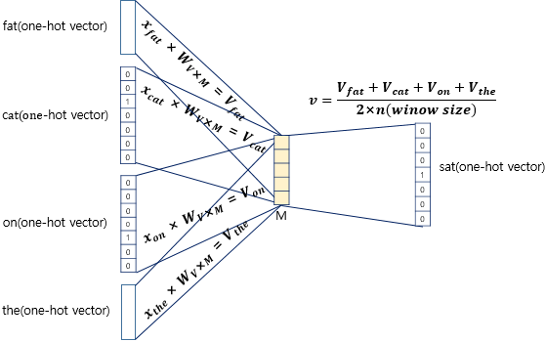
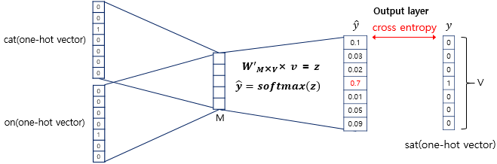
2. Word2Vec
CBOW
ex) The fat cat sat on the mat.
<Input → Hidden>
<Hidden → Output>
출처: NLP wikidocs(https://wikidocs.net/69141)

Slide 6
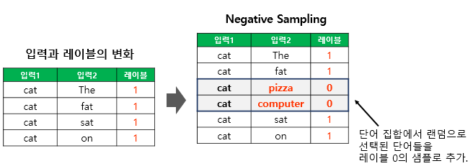
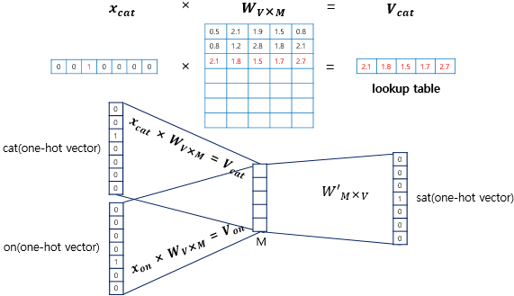
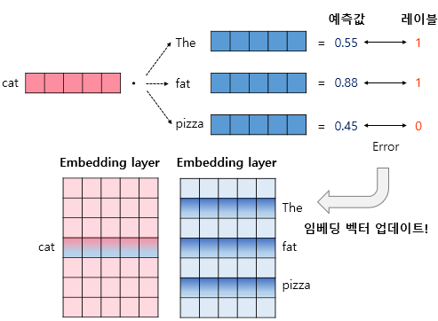
2. Word2Vec – performance improvement
Functionality
Embedding layer(lookup table)
Negative sampling
ex) The fat cat sat on the mat
<Lookup table>
<Negative sampling>

Slide 7
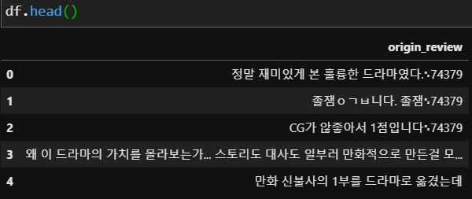
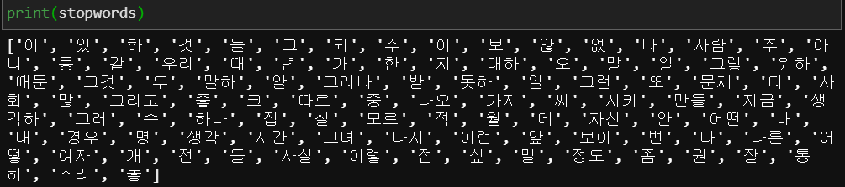
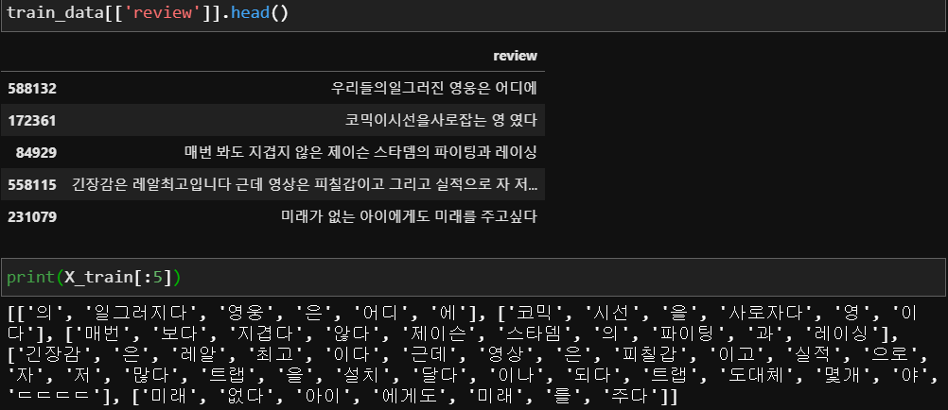
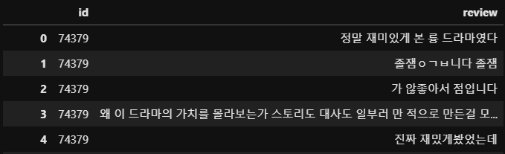
2. Word2Vec – Naver Review
<Original review>
<Stopwords>
<Preprocess review>
<Okt API>

Slide 8
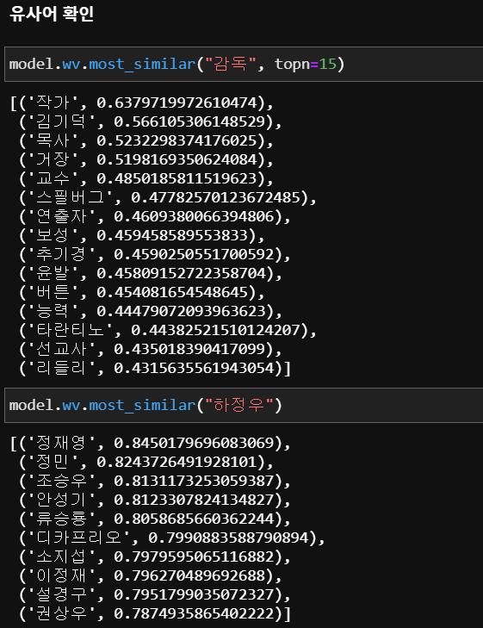
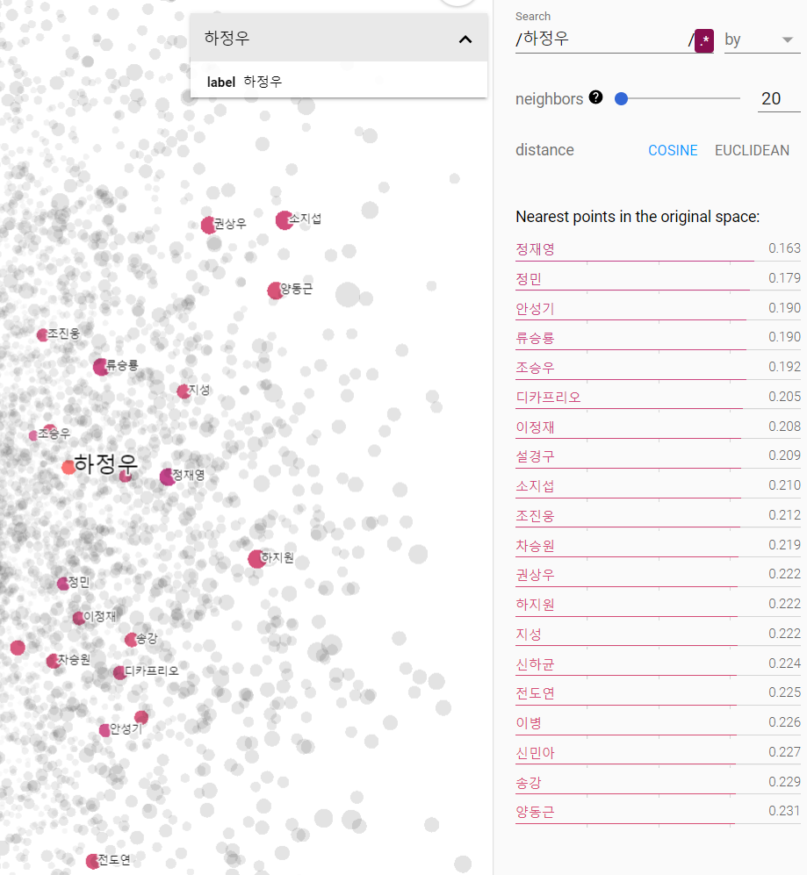
2. Word2Vec – Naver Review
<Similar words>
<Embedding projector>

Slide 9
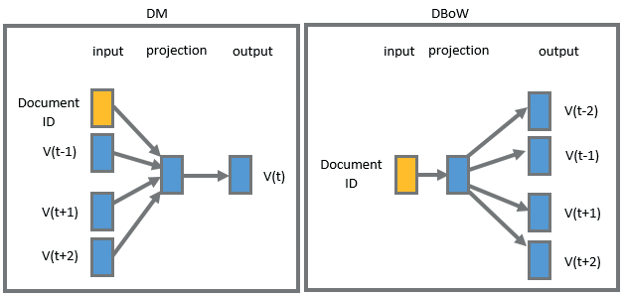
3. Doc2Vec
Type
PV-DM (Distributed Memory Model of Paragraph Vectors)
PV-DBOW : similar word2vec skip-gram
<Model>
출처: https://www.researchgate.net/publication/320829283_Sentiment_analysis_on_Twitter_data_with_semi-supervised_Doc2Vec/figures?lo=1&utm_source=google&utm_medium=organic

Slide 10
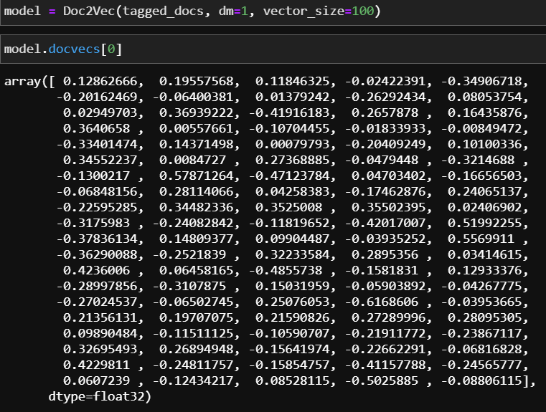
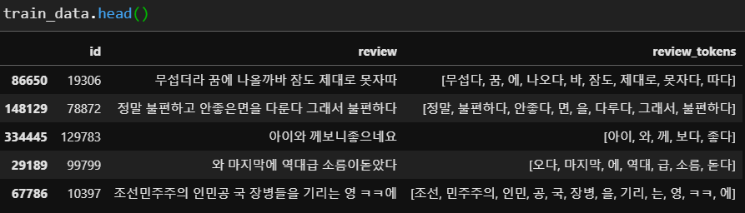
3. Doc2Vec – Naver review
<Preprocess data>
<Embedding vector>

Slide 11
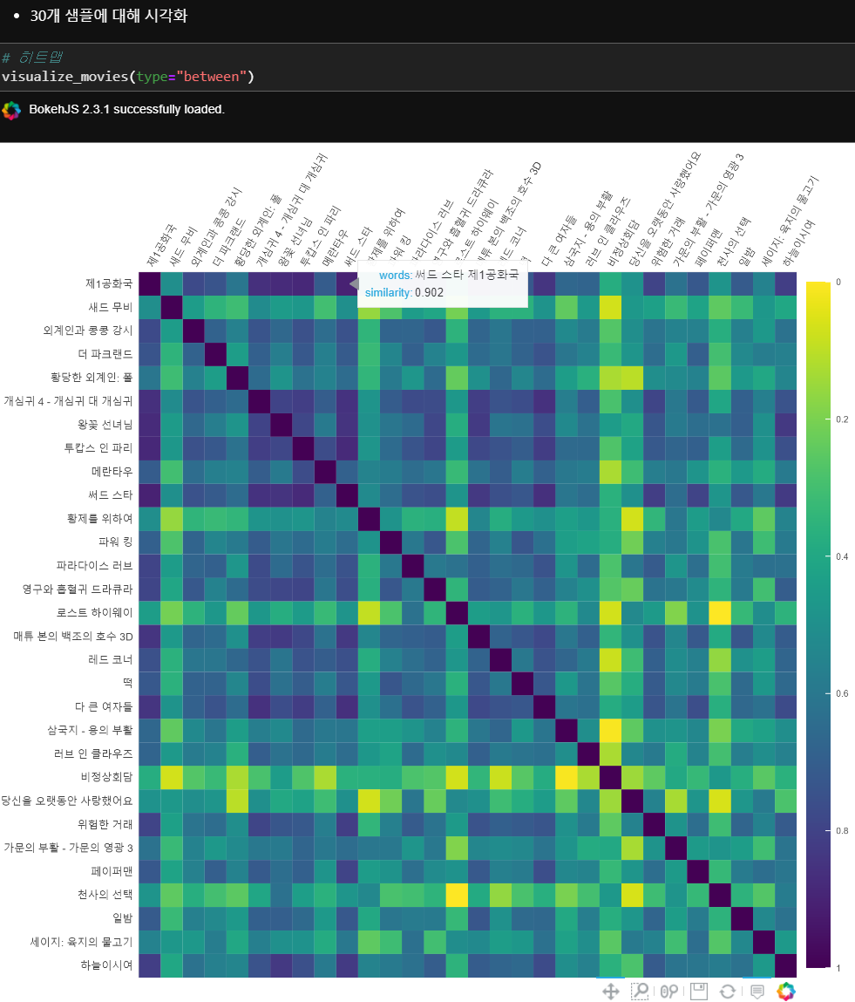
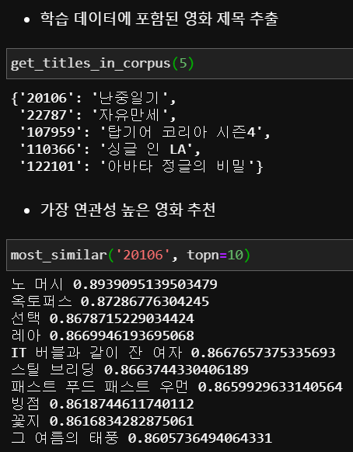
3. Doc2Vec – Naver review
<Extract randomly movie titles>
<Similar movies>
<Visualize>

Slide 12
4. Practice
Dataset
Naver sentiment movie corpus
Word2Vec
Link
Doc2Vec
Link

Slide 13
5. Conclusion
 | Word2Vec | Doc2Vec
Year | 2013 | 2015
Writer | Tomas Mikolov et al. | Andrew M.Dai et al.
Feature | Word vector | Word vector Paragraph vector
Model | CBOW Skip-gram | PV-DM PV-DBOW

Slide 14
Thank you

Slide 15
Appendix
Thank you

Slide 16
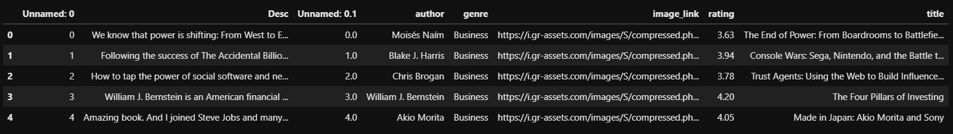
6. Document Embedding
Reference
https://wikidocs.net/102705
Purpose : Calculate the average of word vectors in document
<dataset>
<tokenizing>

Slide 17
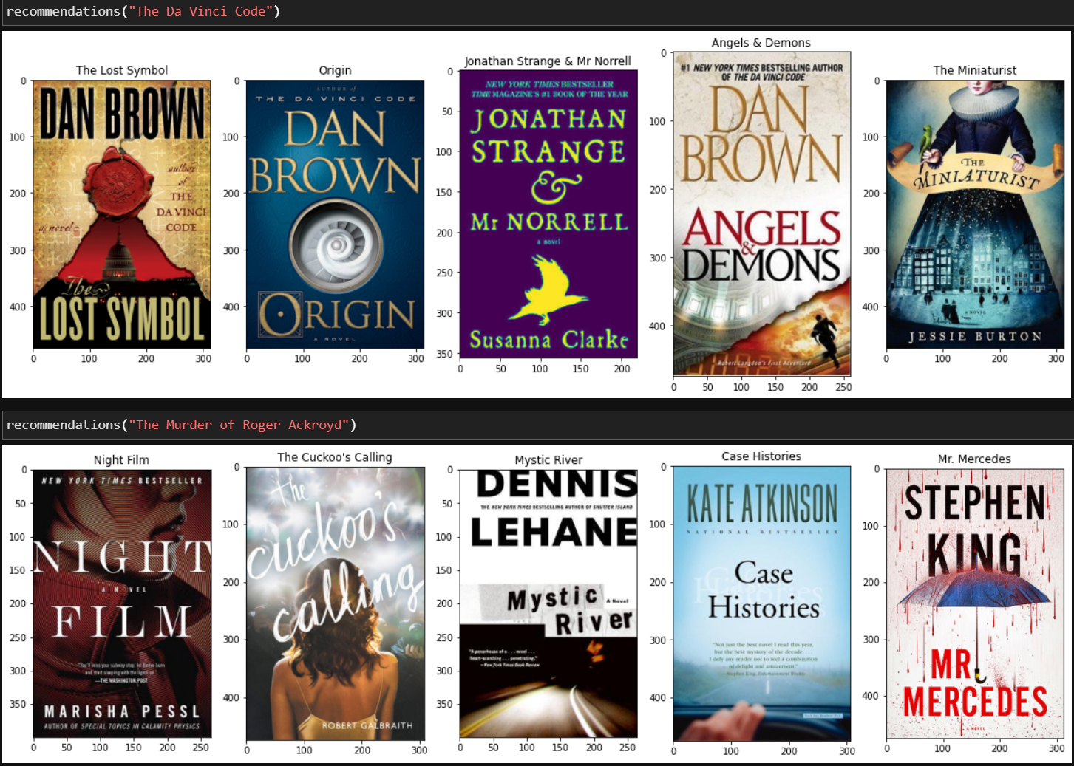
6. Document Embedding
<Recommend similar book title>

